Slide 1

An Efficient Reconciliation Algorithm for Social Networks
Collin Guieb
CS35L Lab 3

Slide 2
OUTLINE
Introduction
Model
Algorithm
Experiment
Conclusions

Slide 3

INTRODUCTION: Context
In the 21st century, social life is online
Connects people and stimulates interaction via the internet

Slide 4

INTRODUCTION: The Problem
Social Network Reconciliation Problem:
Each network represents a subset of your “real” ego-network
We want to identify you across all social media platforms

Slide 5
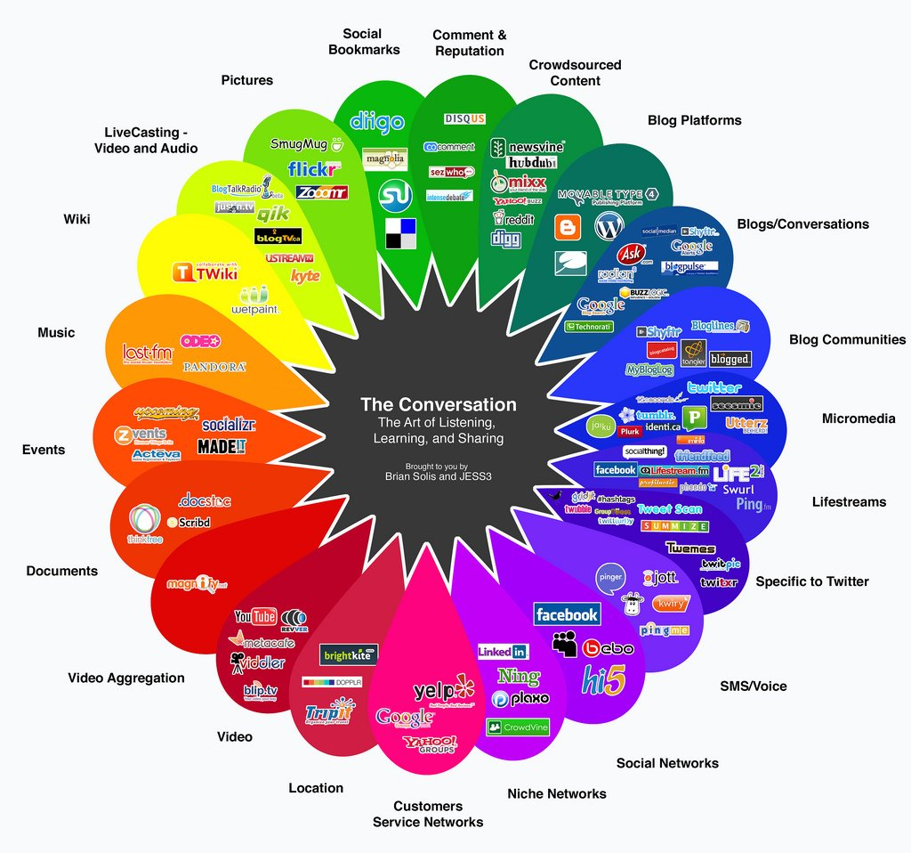

Slide 6
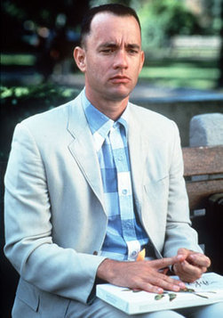
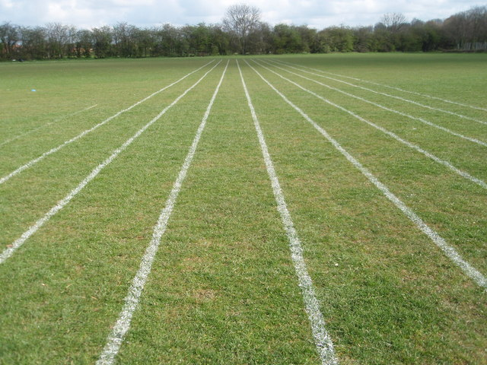
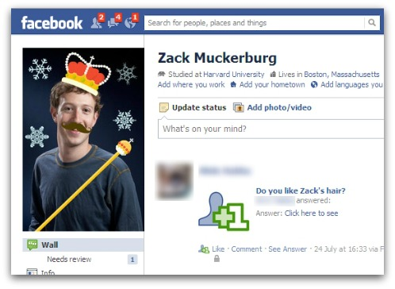
INTRODUCTION: Goals
We want to create an algorithm that is:
simple
parallelizable
robust to malicious users

Slide 7
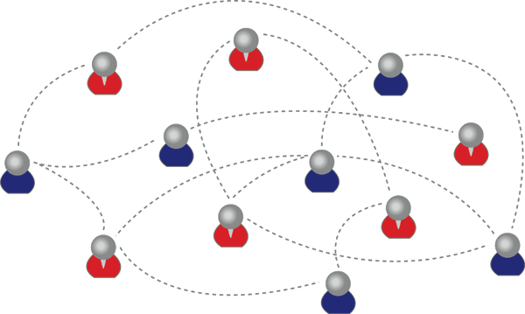
MODEL
BASIC GRAPH THEORY
Ideally, we want to create a “true” unifying graph G (V, E).
Start with G1(v1, e1), G2(v2, e2), … Gn(vn, en)

Slide 8
ALGORITHM
Match users from social network G1(v1,e1) to social network G2(v2,e2) using the User-Matching algorithm.
Delete duplicates and consolidate edges.
Repeat process for n social networks.

Slide 9
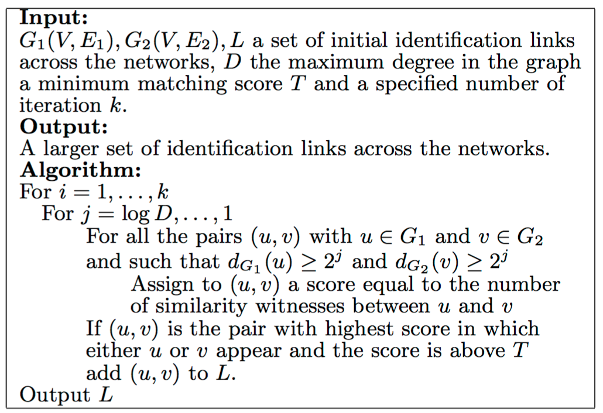

Slide 10
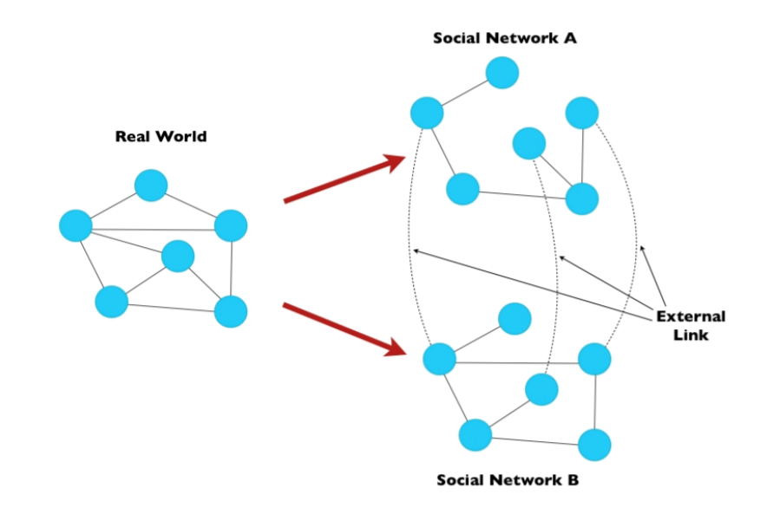

Slide 11
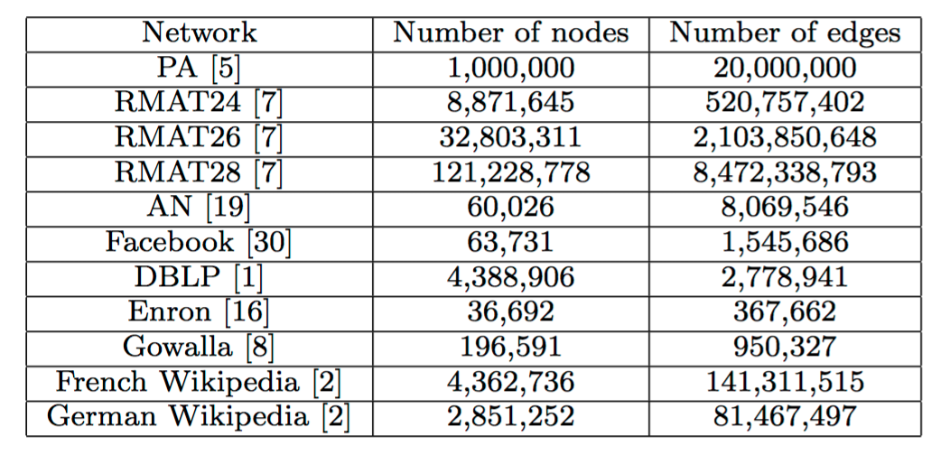
EXPERIMENT

Slide 12


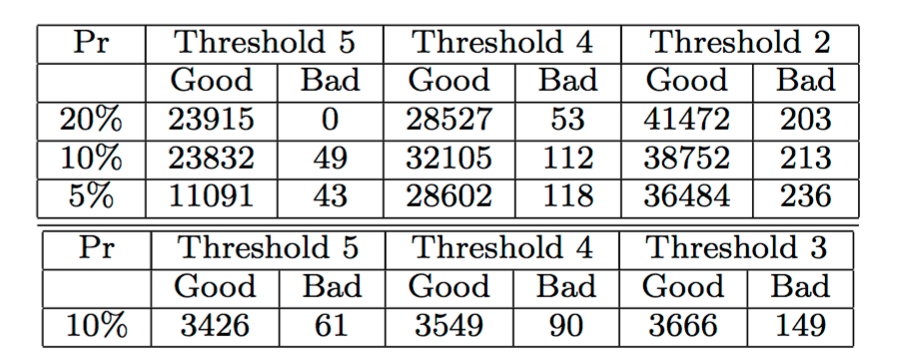
EXPERIMENT
TABLE 1: Results for Facebook (top) and Enron (bottom).

Slide 13


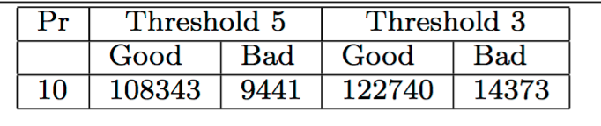
EXPERIMENT
TABLE 2: Combined results for the French and German Wikipedia pages.

Slide 14
CONCLUSIONS
Practical Applications:
better understanding of social dynamics
improved personalized content
essentially creating a worldwide phonebook
Algorithm can be used on other similar databases
Privacy Issues?

